Slide 1
ICT Gaming
Lesson 2

Slide 2
How the Programmer Interacts with the Computer
Objectives
10.3.1: Identify the programmer's role in creating games.
10.3.2: Identify common programming languages and applications used to create computer games.

Slide 3
How We Interact with Computers
Computer science is the study of computers and how they work. It includes the study of both hardware and software.
Computers:
store,
retrieve
and display data (information)
to accomplish the specific task.

Slide 4
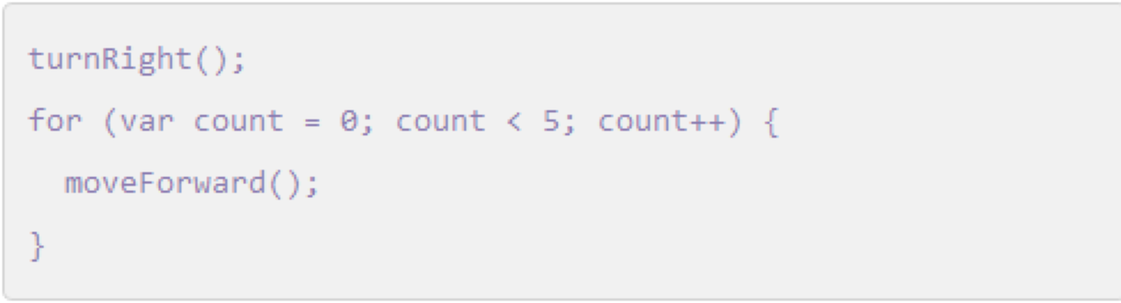
Programming Languages
Software, the programs that computers use, is written in different languages that follow specific rules.
That language uses:
  commands
  and logic statements
Syntax: words and symbols of programming languages.
  Cryptic code with a bit of English included.

Slide 5
Programmers and Languages
Programmers write instructions:
A series of statements using the code and syntax for a particular programming language.
Common programming languages: C++, .NET, & java
Program developers choose the programming languages they will use based on which platform and device the program will be using, such as Windows, Mac, Android or iOS.

Slide 6
Understanding Algorithms
Objectives
10.3.3: Compare sequential, iteration (loop) and selection programming structures.
10.3.4: Define the term algorithm (i.e., a set of repeatable steps) and how it applies to problem-solving.
10.3.5: Create an algorithm to solve a problem or complete a task.

Slide 7

Understanding Algorithms
An algorithm is a set of step-by-step instructions that must be executed in order to solve a problem or perform a task.
They tell the computer what to do and how to do it.

Slide 8
Successfully Completing a Task
In order to successfully complete a task, you must be able to:
identifying and understand the problem,
use logic to plan a solution to a problem,
create the procedures needed to execute the solution,
and finally test and refining the solution.

Slide 9
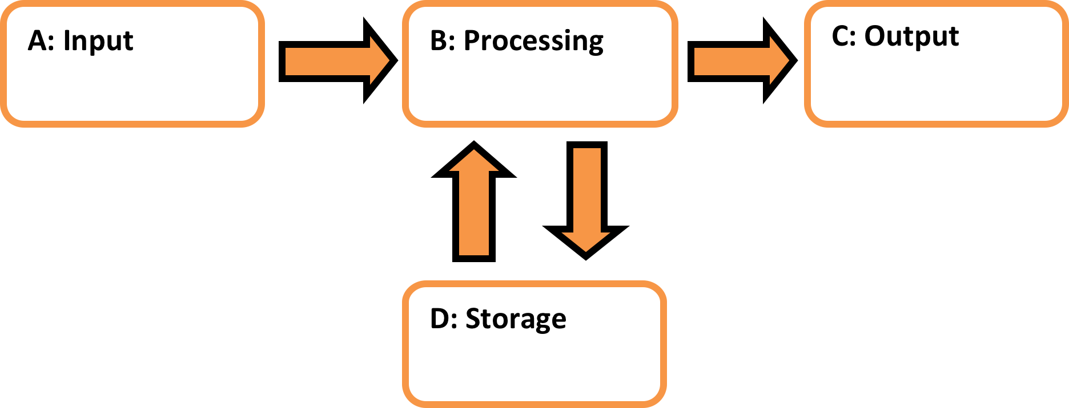
Computing Cycle
Computer programs contain data and a set of instructions that tells a computer what to do to accomplish a specific task or solve a particular problem using the data provided.
When a computer performs the programmed tasks, that is called “Executing” instructions.

Slide 10
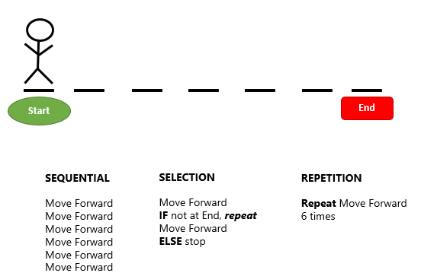
Programming Structures
Efficient algorithms make use of three main programming structures: sequential, selection and repetition (or looping).
A sequential programming structure is a sequence of instructions that the computer follows in order, one by one, from top to bottom.

Slide 11
Programming Structures
Selection programming structure allows the computer to make a selection between alternative conditions (for example, if this condition exists, do this — if not, do that). The computer first assesses the condition and then makes a decision about how to proceed. An example of a selection structure is the if/else statement.

Slide 12
Programming Structures
Repetition or looping programming structures instruct the computer to repeat a set of instructions, called a loop, until some condition is met. Repetition structures include the while, do/while and for statements.

Slide 13
Introduction to Flowcharts & Pseudocode
Objectives
10.3.6: Use pseudocode to model a game program's flow.
10.3.7: Define logic errors and identify them in a game program or model.

Slide 14
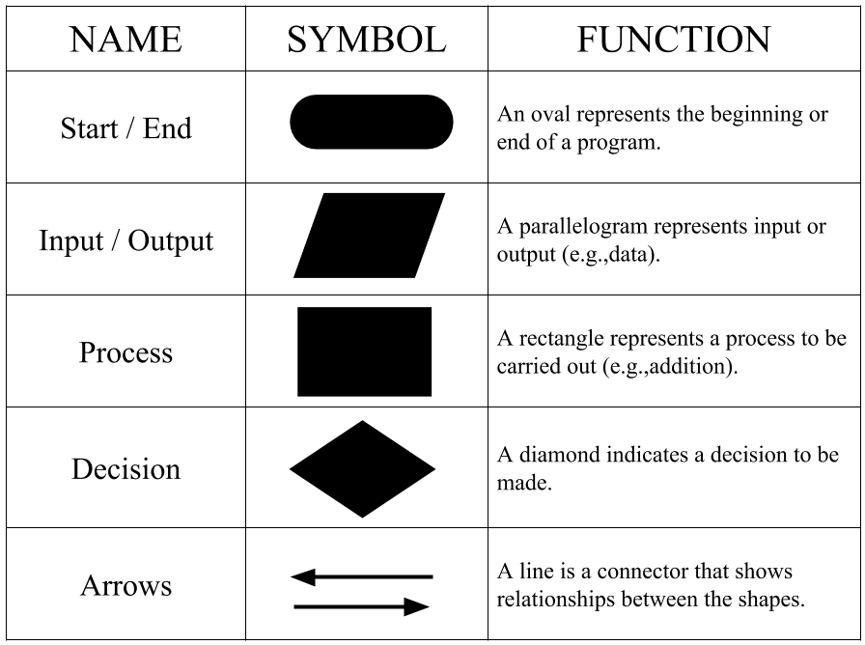
Flowcharts
Flow charts are graphical diagrams that show the steps or decision process contained in an algorithm.
Flow charts contain different symbols to represent the purpose or process of a particular step.

Slide 15
Game Controller Flowchart

Slide 16
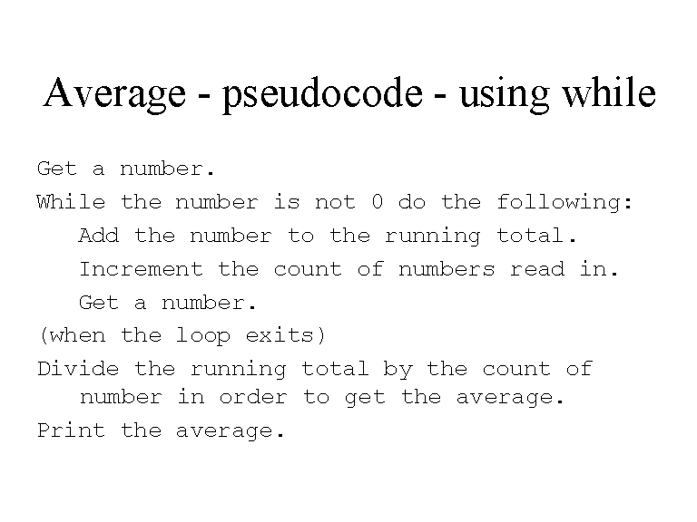
Pseudocode
Pseudocode is a way of writing the details of algorithm steps in plain text using short phrases
Benefit: They allow the programmer to focus on the logic of the algorithm and make refinements before translating it into programming language statements

Slide 17
Programming Logic
Logic statements control the flow of a program.
They are a specific form of IF…THEN…ELSE statements.
IF a condition is true (or an action occurs), THEN a reaction (or effect) will occur.
For example, if the condition "Do you know your password?" is answered TRUE (yes), THEN you can access the website.
If the condition is FALSE (no), then the ELSE event is initiated, which is "You cannot access the website.”

Slide 18
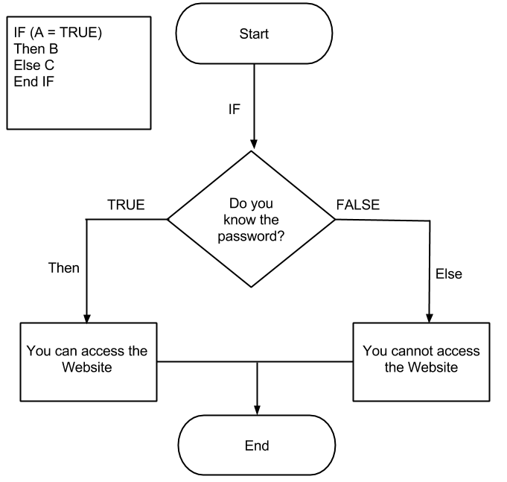
Logic Statements
Control the flow of a program
 | Condition/Cause |  | Action/Effect
IF | I am tired | THEN | I will take a nap
IF | I am thirsty | THEN | I will drink water
IF | I have a test | THEN | I will study

Slide 19
Programming Errors
ERROR | DESCRIPTION
LOGIC | A logic error causes the program to produce unexpected results. Common logic errors include incorrect sequence of instructions or wrong formula used in a calculation. Logic errors can be difficult to identify, because the program still runs but it does not do what you expect it to do.
SYNTAX | A syntax error is usually found by the compiler in the computer when it does not understand or recognize the code as typed. Common syntax errors include misspelled words or missing code. Syntax errors normally stop the program from running successfully.
RUNTIME | A runtime error occurs when the program is running. It generally means a piece of code cannot be loaded or contains an error that causes the program to stop.

Slide 20
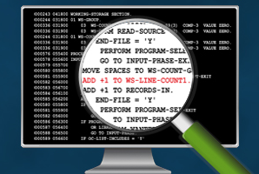
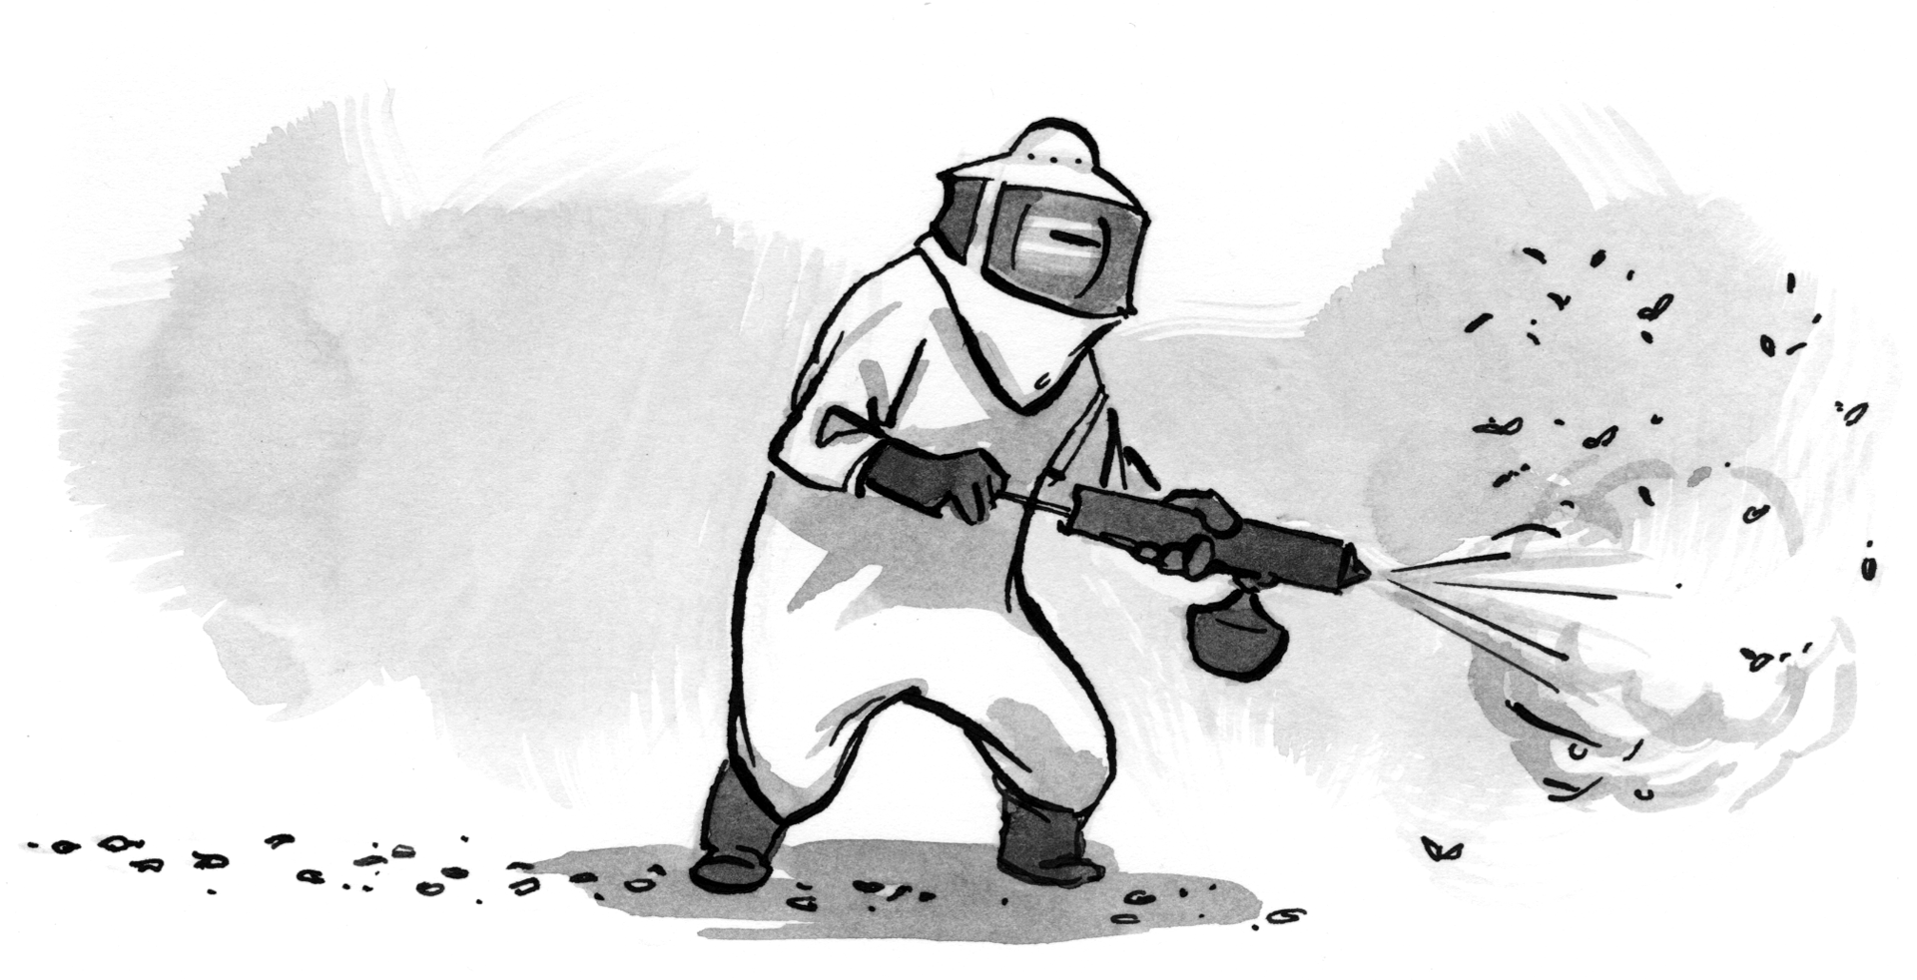
Testing & Debugging
Debugging (troubleshooting): finding and fixing errors

